Slide 1
FACILITATORS TRAINING
RHCCC FELLOWSHIPS LEARNING
P SOPHIA & P KELVIN

Slide 2
Focus of campaign
Go DEEPER – Anticipate in daily worshipping God and Respond to God’s call and purpose for us. Our Purpose pastors have written 25 devotional articles to draw us to the Word. Alongside these devotional readings, there will be real life testimony from each people group.
​
Go WITH – Journey with others, especially seekers and newcomers in your small group. Take this opportunity to Identify and allow hosts and facilitators to lead/co-lead small group discussion. ​
Go OUT – Get out of your comfort zone to serve. There will be six weeks of sermons and action plans to bless the community in ways that will shape us to live out a healthy, growing, biblically- based, and full of love community.​
Go FORWARD – After all, our faith is not in what we can do throughout the campaign, but in what He will be doing within our lives and around our lives.​

Slide 3
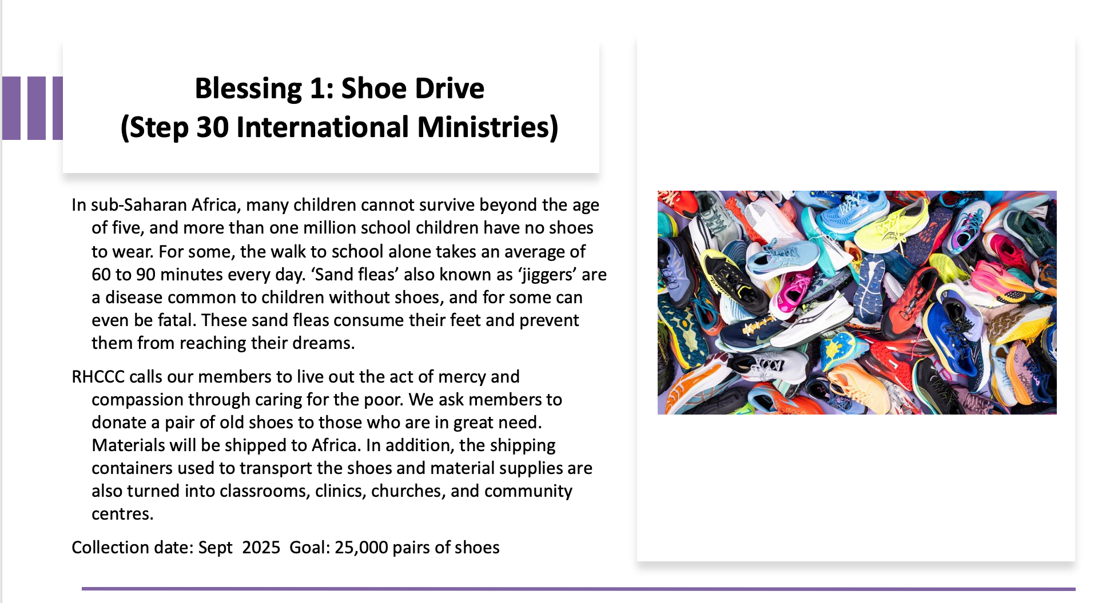

Slide 4
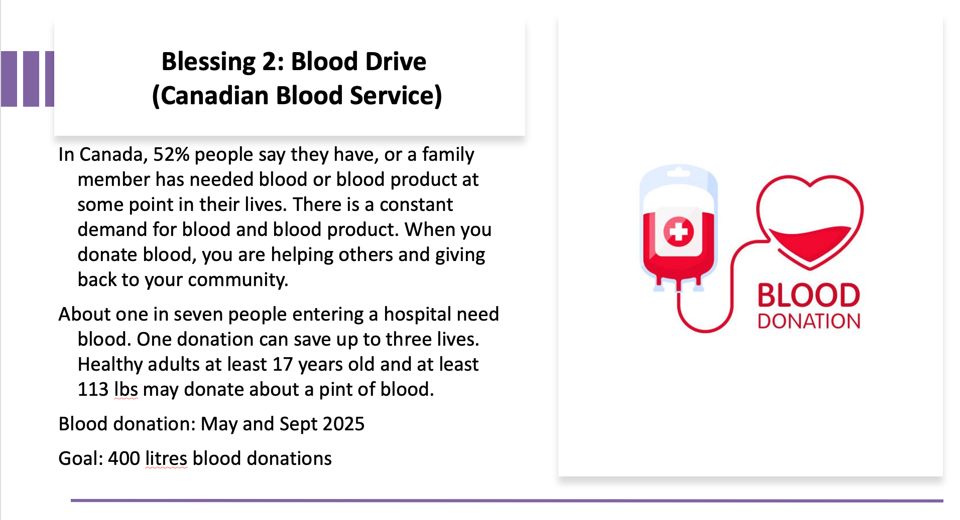

Slide 5
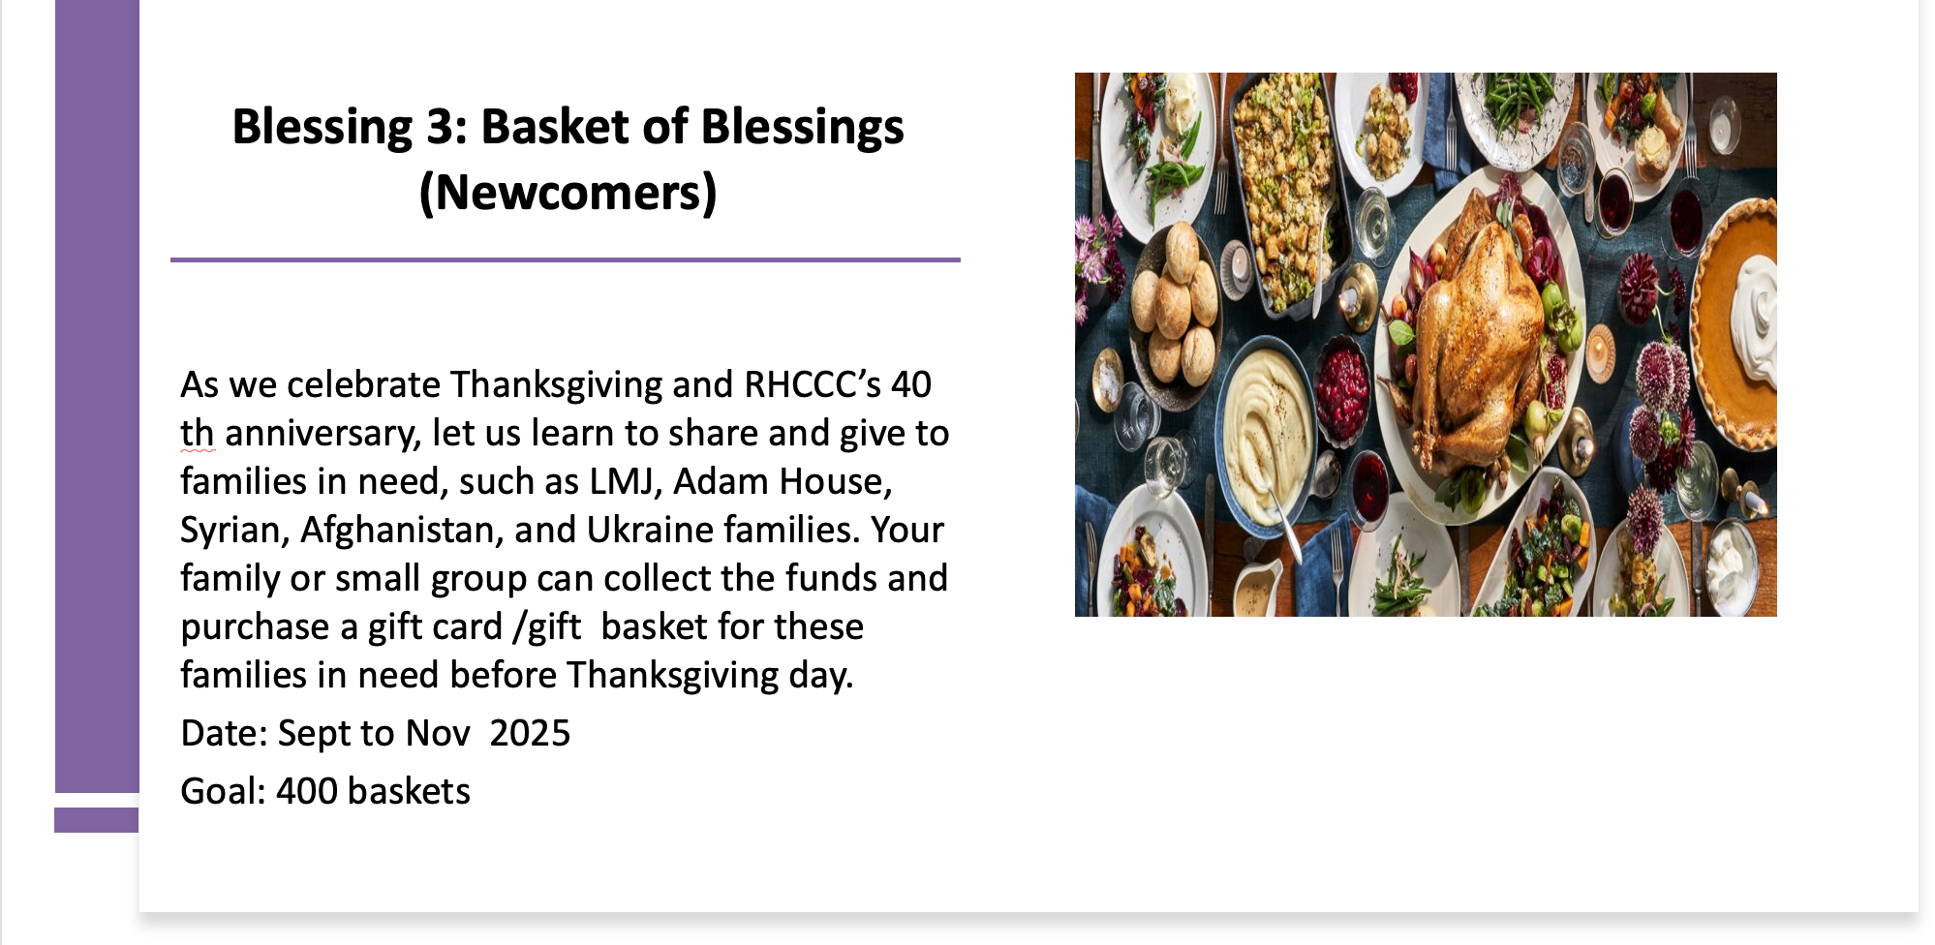

Slide 6
Prayer for Small group facilitators: (by P Sophia)
Heavenly Father, we thank you for your calling and equipping each SG facilitator for such a time as this. During this 40 – day spiritual journey, we pray for a fresh wind of Your Spirit to move among us.
Releasing us from fear and lifting the weight of every burden we carry old wounds, doubts, and distractions, help us to walk in freedom and boldness.
We pray for the facilitators - to be channel of Your hope – humble and filled with grace.
We pray for the preachers - speaking directly to the hearts and situations of every member.
We pray for those who share the testimony– authentic and give glory to You.
We pray for the members – revive and renew us.
We pray for these 40 days to be a time of wholehearted response and renewal. Not just in knowledge, but the way we live and love.
Unite us on One Mission, One Mind, One Voice, One Spirit – for Your glory and the good of our communities.
In Jesus’ name we pray, Amen.

Slide 7


DIFFICULTIES IN LEADING BIBLE STUDY

Slide 8
TEACHER VS FACILITATOR
Teaching | Facilitating
delivering knowledge | drawing out knowledge
telling information | asking question
focus on content | focus on process
unidirectional | interactional
they learn and understand | they share and reflect

Slide 9
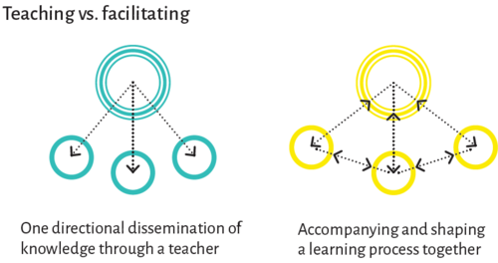
TEACHER VS FACILITATOR
PASSIVE PARTICIPATION
ACTIVE PARTICIPATION

Slide 10
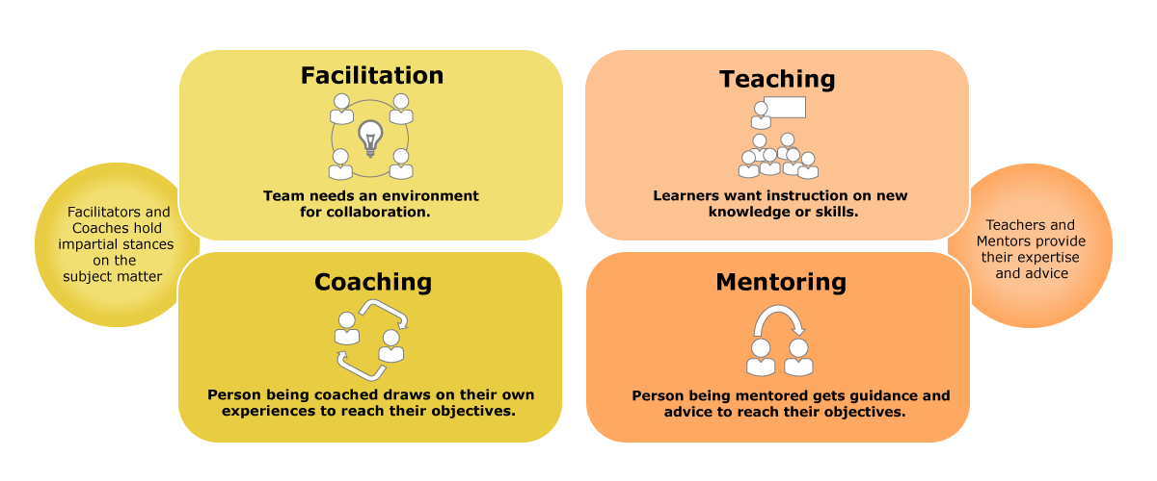
TEACHER VS FACILITATOR
PROCESS-FOCUSED
CONTENT-FOCUSED
GROUP
PERSONAL

Slide 11
HEART OF A FACILITATOR
WHAT ATTITUDES ARE REQUIRED OF
A FACILITATOR?

Slide 12

HEART OF A FACILITATOR
  CURIOSITY
  ACTIVE LISTENING
  INCLUSIVE
  FLEXIBLE
  MUTUAL LEARNING

Slide 13
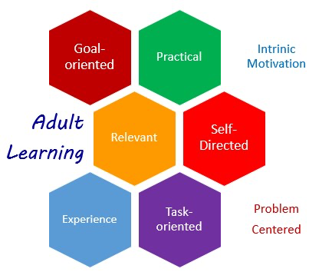
ADULT LEARNING MOTIVATION

Slide 14

ADULT LEARNING MOTIVATION BY FACILITATION
Me
Us
World

Slide 15
ASKING FACILITATIVE QUESTIONS
  Reflective Questions
  What does this passage of scripture remind you of today?
  What difficulties and struggles does this passage remind you of?
  Clarifying Questions
  You just mentioned this situation, can you say more about it?
  You mean...?
  Probing Questions
  What are the reasons that lead you to such feelings/conclusions?
  What is preventing you from making new changes/actions?

Slide 16
ASKING FACILITATIVE QUESTIONS
4. Hypothetical Questions
  If you were a character in this passage, what would you observe?
  If other people/circumstances don’t change, how do you expect yourself to change to adapt?
5. Critical Questions
  Is there anything in this passage that requires further in-depth study to help us better understand it?
  What past misunderstandings did this passage clarify?
6. Interactive Questions
  What do you think, Jaygo, about Jason's views?
  Does anyone want to respond to Mary’s sharing or want to know more?

Slide 17
ASKING FACILITATIVE QUESTIONS
Inspiration
Interaction

Slide 18


INTERACTIVE SMALL GROUPS

Slide 19
INTERACTIVE SMALL GROUPS
  Ask open-ended questions
  Encourage mutual interaction
  Active listening
  Create a safe environment
  Keep relevant to the topic
  Don’t dominate the discussion
  Don’t criticize and judge
  Don’t let one person take over
  Don’t rush through the discussion
  Don’t force a specific conclusion

Slide 20
IN EACH GROUP SESSION
  Worship and Opening Prayer (10 mins)
  Review sermon and sermon-based questions (30 mins)
  Reflect on Devotional Journals/ Testimony clips (30 mins)
  Respond: How can your group take part in the Blessings (10 mins)
  Encourage and pray for each other (10 mins)

Slide 21
FACILITATIVE BIBLE STUDY
  Rephrase: Put the Scripture into your own words
  How would you express this verse if you were sharing it with a friend?
  2. Relevance: What is the Scripture saying to you right now?
  How does it speak into your current situation, struggles, or season
  3. Response: What is God saying to comfort, remind, or challenge you?
  Is there a word of encouragement, correction, or invitation?
  4. Renewal: What change do you hope to see today?
  In your mindset, heart, relationships, or actions?

Slide 22
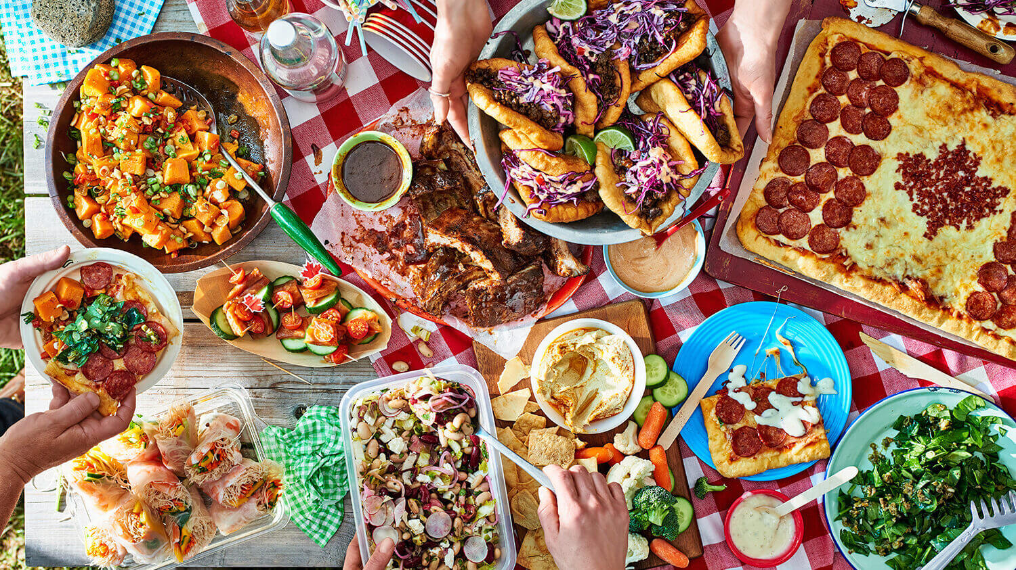
FACILITATIVE SPIRIT
...together with all the Lord’s holy people, to grasp how wide and long and high and deep is the love of Christ...(Eph 3:18)

